Slide 1
Density Estimation
(Parametric Approach)

Slide 2
Parametric Approach
P(Y|X)=P(X|Y)P(Y)/P(X)
P(Y):easy. Experience or training data.
P(X|Y):difficult. Too few training data; high-dimensional feature space (computation,storage).
Parametric Approach
  Form known
  Parameters unknown

Slide 3
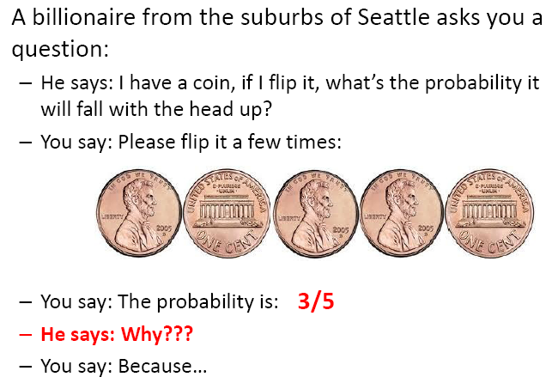
Your first consulting job

Slide 4
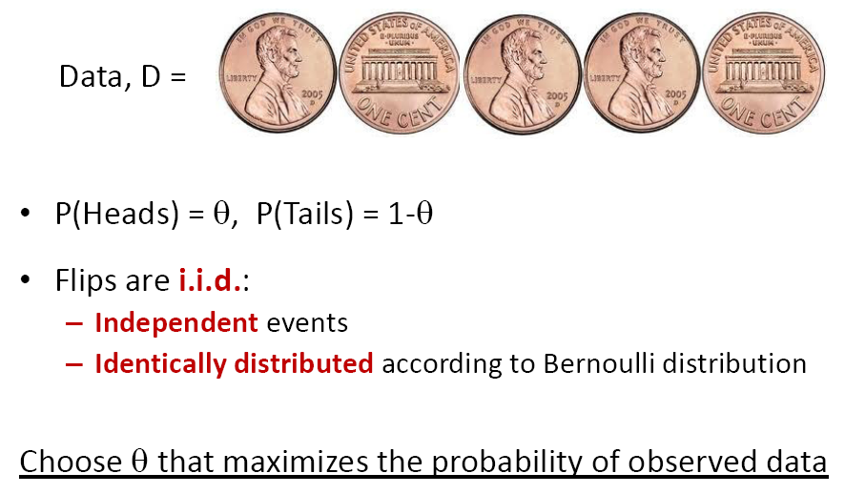
Bernoulli Distribution

Slide 5
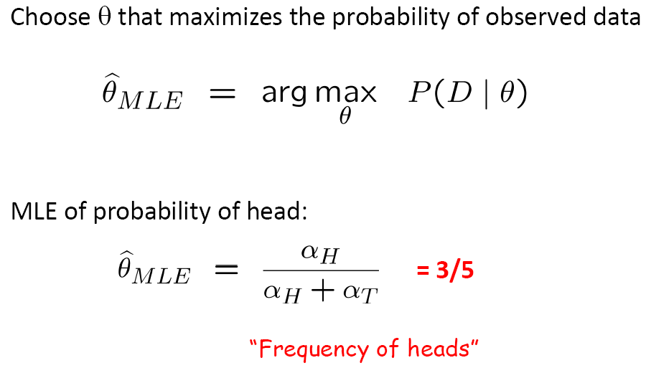
Maximum Likelihood Estimation

Slide 6
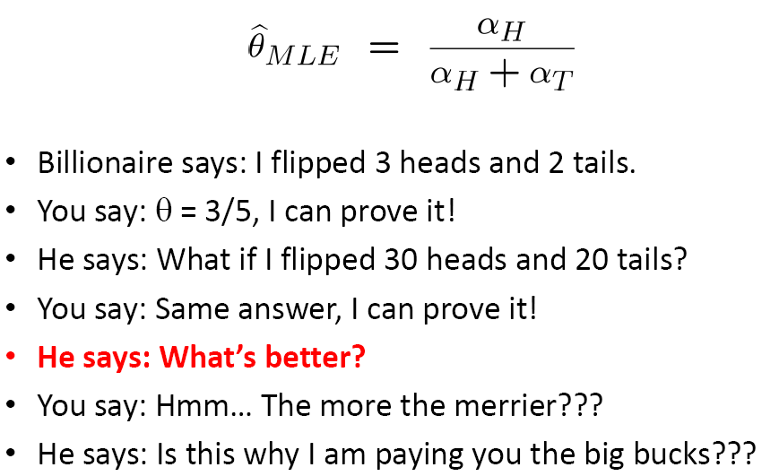
How many flips do I need?

Slide 7
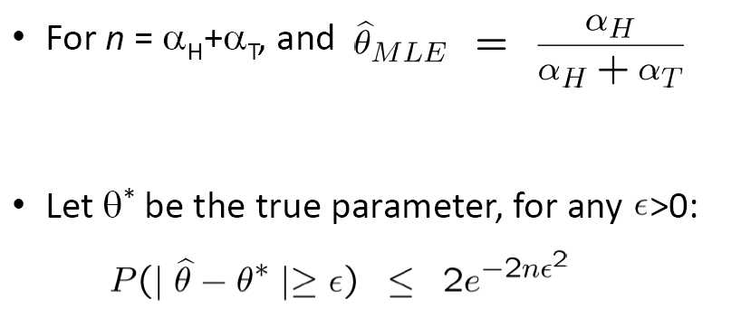
Simple bound (Hoeffding’s inequality)

Slide 8
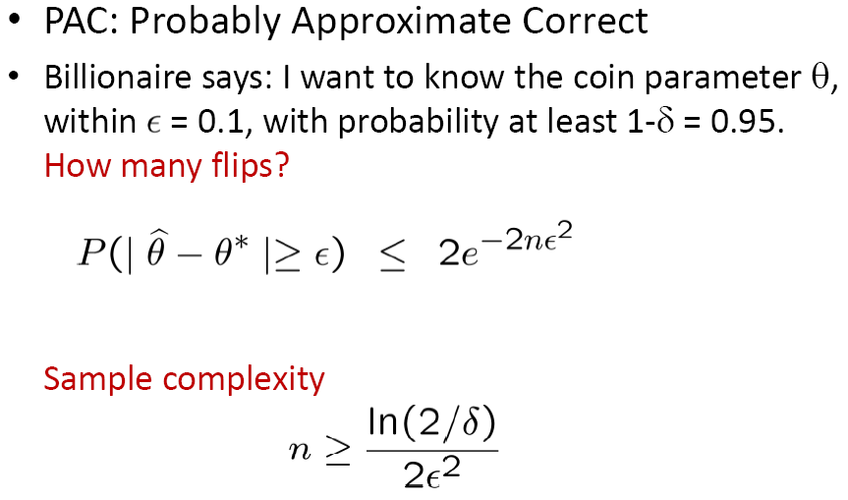
PAC Learning

Slide 9
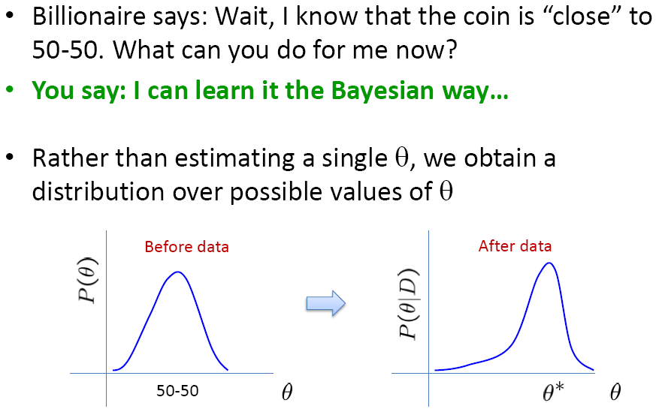
What about prior knowledge?

Slide 10
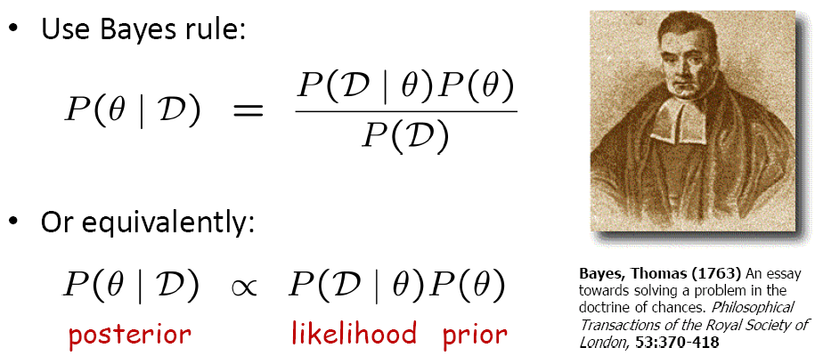
Bayesian Learning

Slide 11
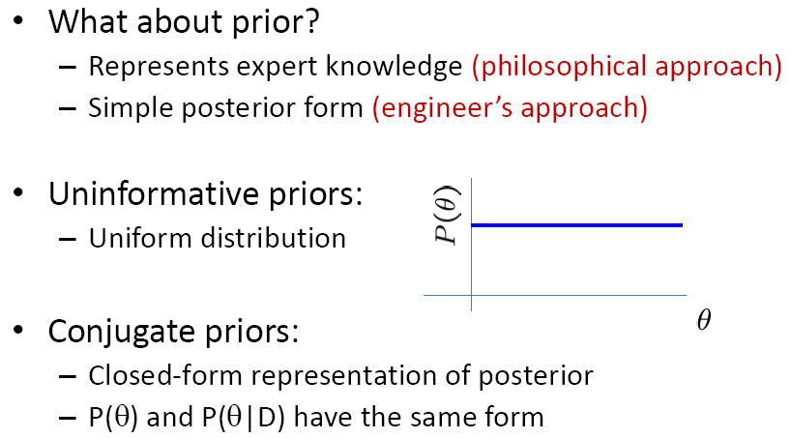
Prior Distribution

Slide 12
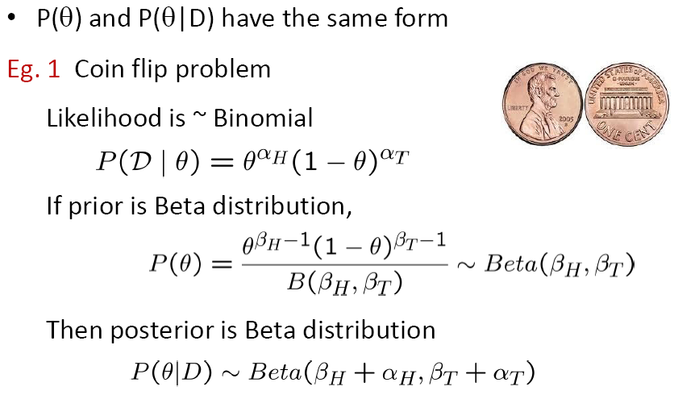
Conjugate Prior (I)

Slide 13
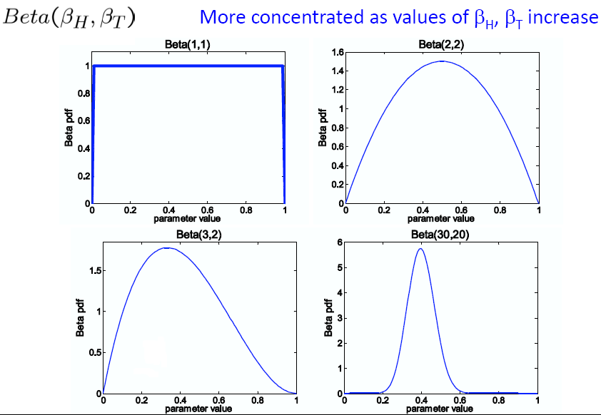
Beta Distribution

Slide 14
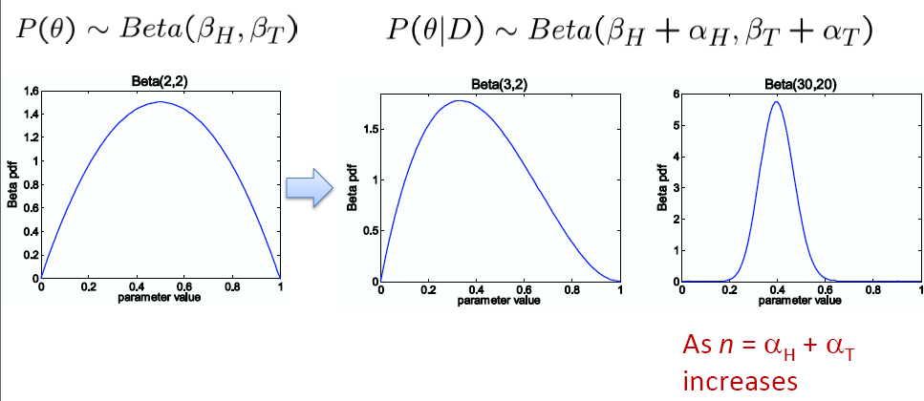
Beta conjugate prior

Slide 15
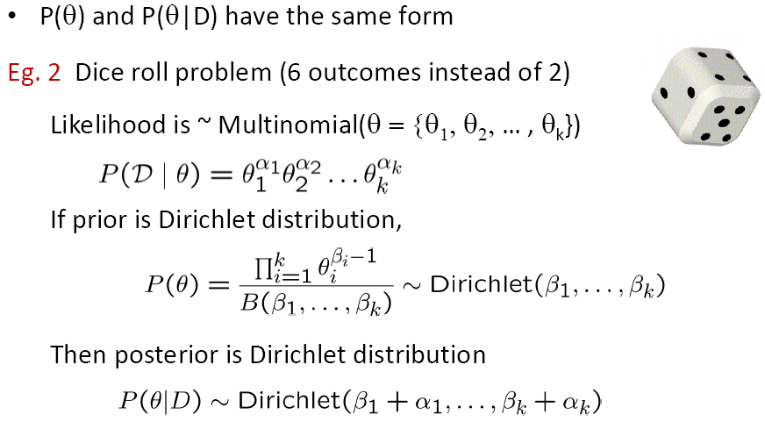
Conjugate Prior (II)

Slide 16
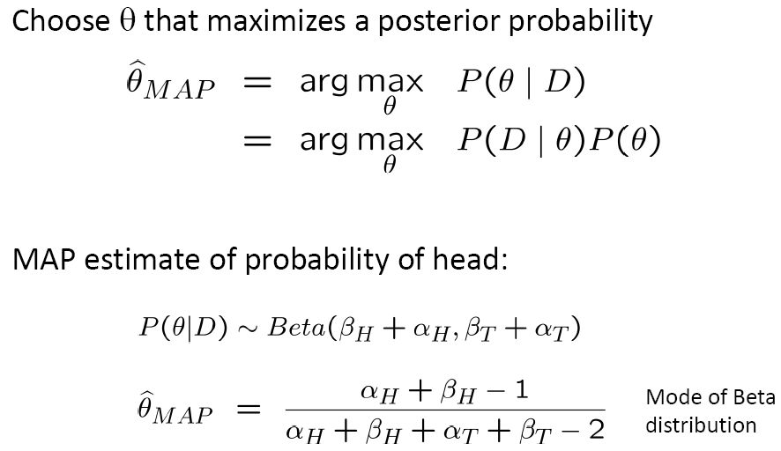
Maximum A Posterior Estimation

Slide 17
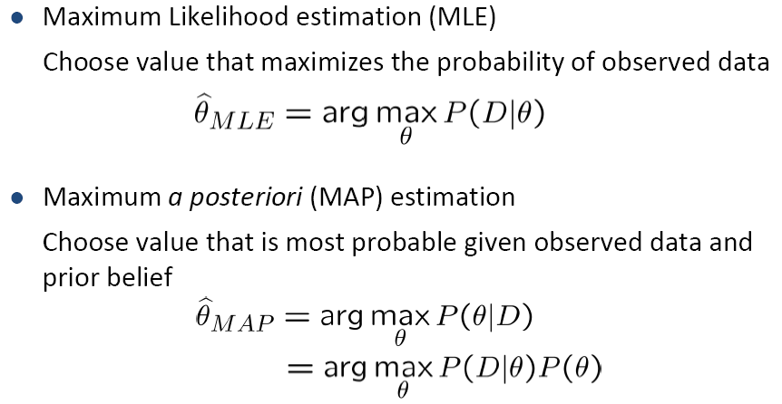

MLE vs. MAP

Slide 18
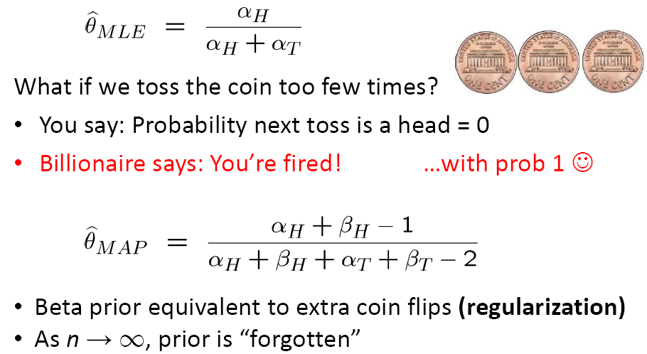

Slide 19
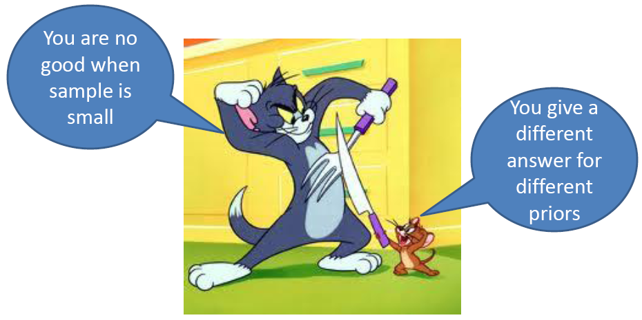
Bayesian vs. Frequentists

Slide 20
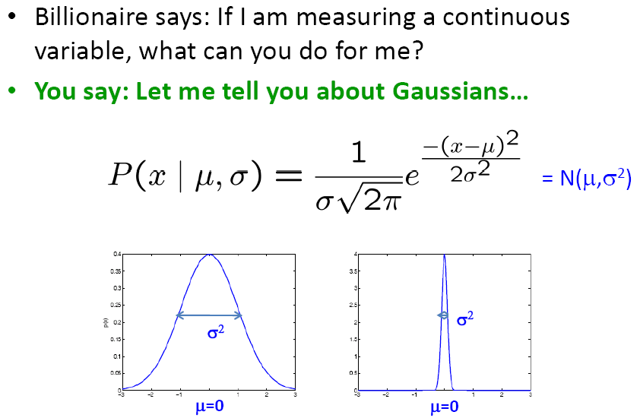
What about continuous variables?

Slide 21
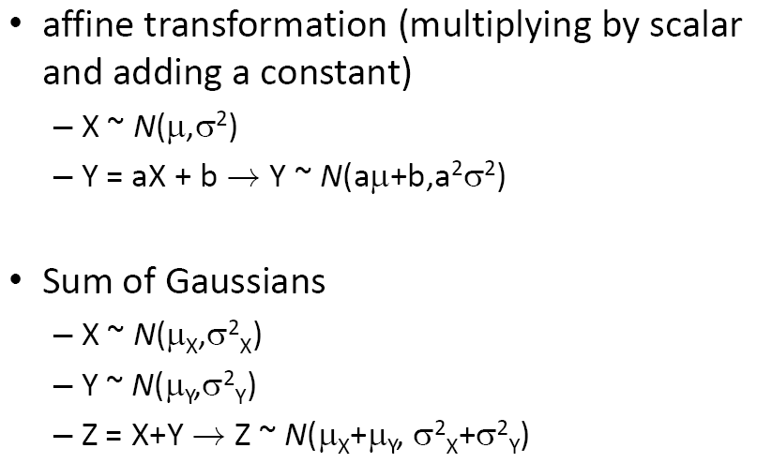
Properties of Gaussians

Slide 22
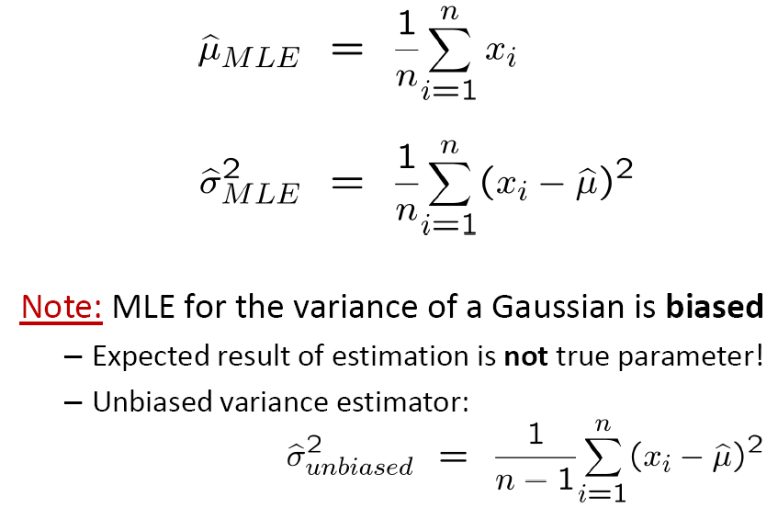
MLE for Gaussian mean and variance

Slide 23

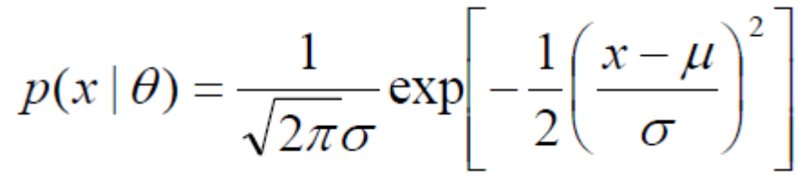
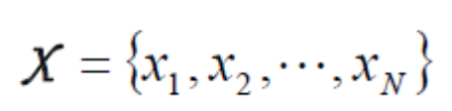
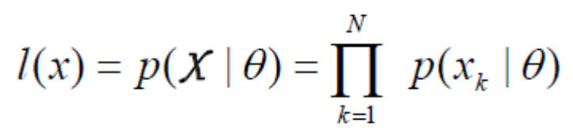
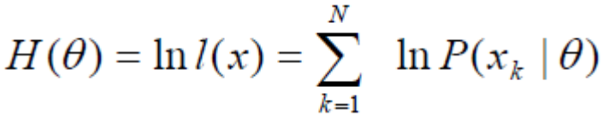
Proof

Slide 24
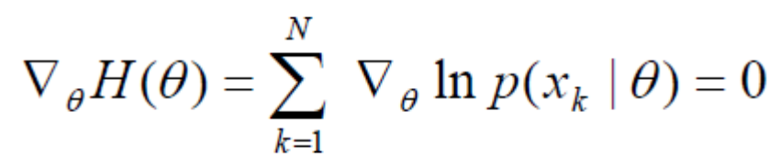

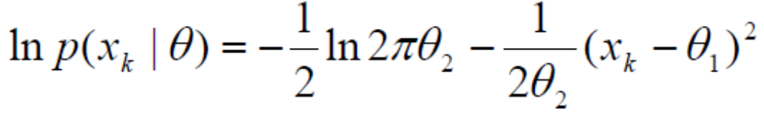
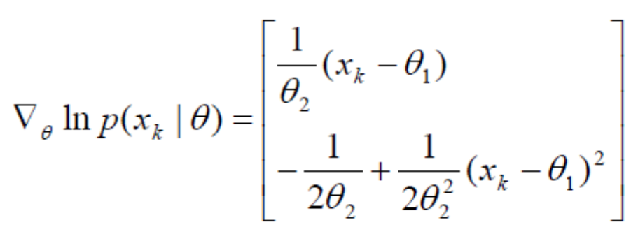
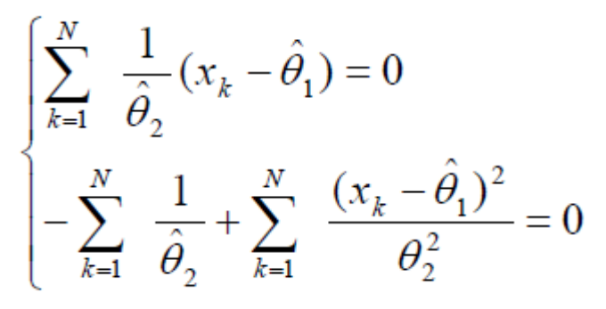
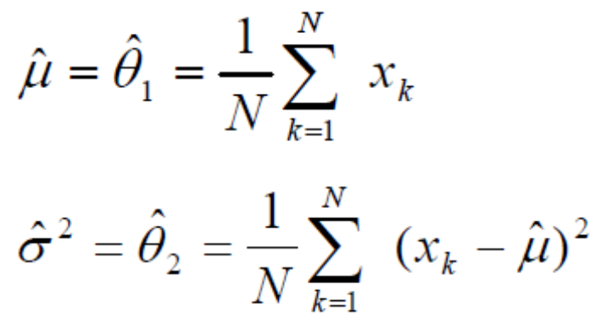
Proof

Slide 25
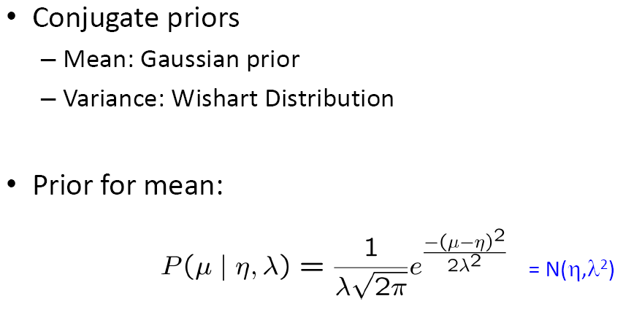
MAP for Gaussian mean and variance

Slide 26
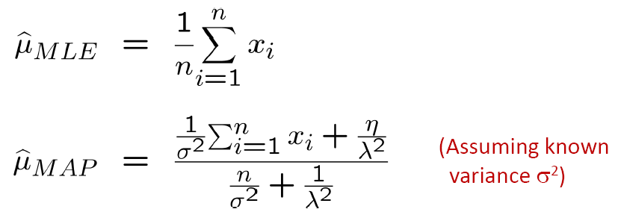
MAP for Gaussian Mean

Slide 27
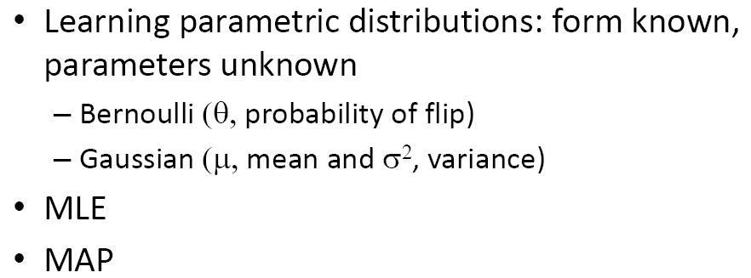
What you should know…

